Slide 1
Project Phase 1
By Stephen Ndirangu

Slide 2
Business understanding
Microsoft sees all the big companies creating original video content and they want to get in on the fun. They have decided to create a new movie studio, but they don’t know anything about creating movies.¶
This analysis is to help reveal insights for Microsoft's new movie studio.The point of interest is which movies are doing well currently in the box office.
This analysis will focus on ratings and revenue of the movies as the relevant information

Slide 3
Data used:
Box office Mojo dataset
IMDB SQL database
The numbers dataset
They are trustworthy as they are legitimate sites for getting reviews for movies

Slide 4
Methods used
Data cleaning, choosing to drop Nan columns if many, eg Runtime Minutes had however, kept some and renamed to “Missing” instead for Genres
Dropped Entire Column “Foreign gross” in the second dataset, as the 3rd dataset would have worldwide gross

Slide 5
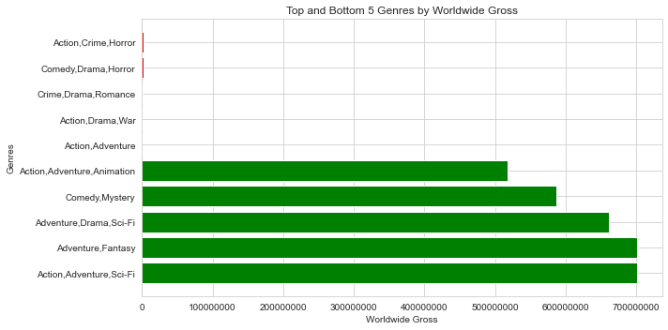
Top and bottom 5 Genres based on Worldwide Gross

Slide 6
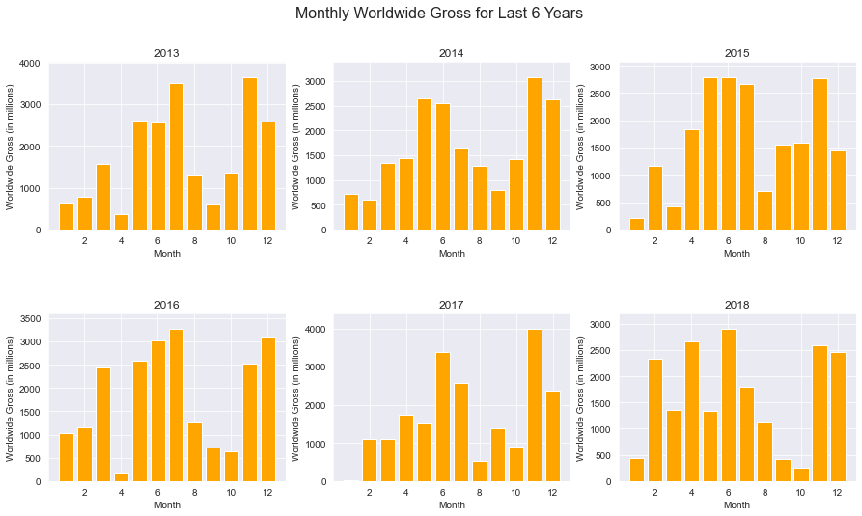
Monthly gross per month in last 6 years

Slide 7
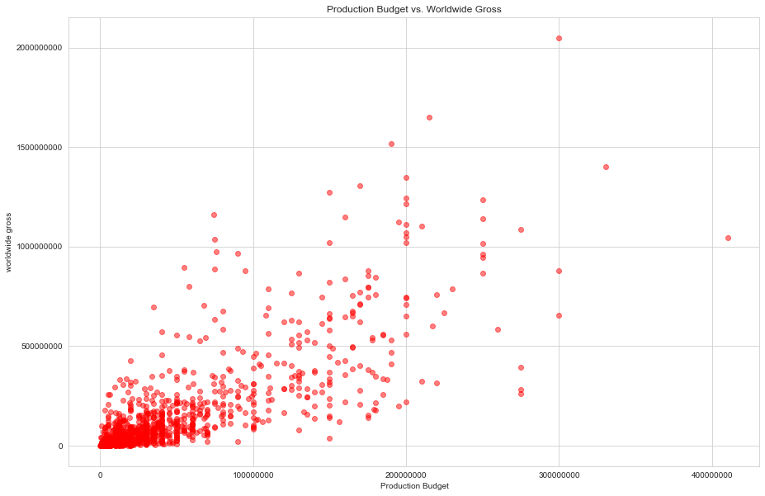
Budget vs Worldwide Gross

Slide 8
Conclusion
Budget
The production budget has very strong positive correlation with the domestic and worldwide grosses
Average rating
-movies rated higher did much better in the box office,both for domestic and worlwide audiences, and in fact, movies rated lower than 5 did very poor
-curiously, the rating isn't really affected by increased budget, probably due to the fact that many things go into a production
-it would seem the average rating has a weak positive correlation with both domestic and worldwide gross,
Genre
Generally genres dont really affect a rating, but the top 5 that make money worldwide are anything of the "adventure genre" involving scifi, animation and comedy
### Runtime
-Rating has a strong positive correlation with the runtime of the movie, but closer investigation shows the dirstibution is clustered within a value range of 80 to 140 minutes
Month of release
-it would seem from the per-year and mean of 5 years bar plots, that in the middle of the year and in November, these are the best times to release movies

Slide 9
Recommendations to Microsoft
1) Mirosoft should invest in the Genres of Adventure, with scifi,comedy,and/or animation, with main projects being of the genre "Adventure,Drama,Scifi" as it gets high reviews as well as high grossing worldwide
2) A high budget in these genres will give better returns worldwide, somewhere above the 100 million mark
3)A runtime of Between 80 minutes and 140 minutes is the most consistent at good ratings
4) Releasing between months 4-6, and at the tail end of the year might also give good worldwide grosses...probably because these are the months in which holidays occur eg easter, christmas

